Slide 1


Hadronic Matter’2016
NICA Accelerator Complex :
Status, Problems, Perspectives
Igor Meshkov, Anatoly Sidorin and Grigory Trubnikov
for the NICA team
JINR, Dubna
31.10.2016

Slide 2
Outline
Introduction: The NICA project at JINR
1. NICA @ Heavy Ion mode – Stages I & II of the project
2. NICA construction
3. Strategy of The Project Luminosity Achievement
4. Start up mode of the NICA operation
5. NICA – Stage III: Collider of polarized beams
6. Requirements and questions (to be discussed and answered)
Conclusion: the NICA beams

Slide 3
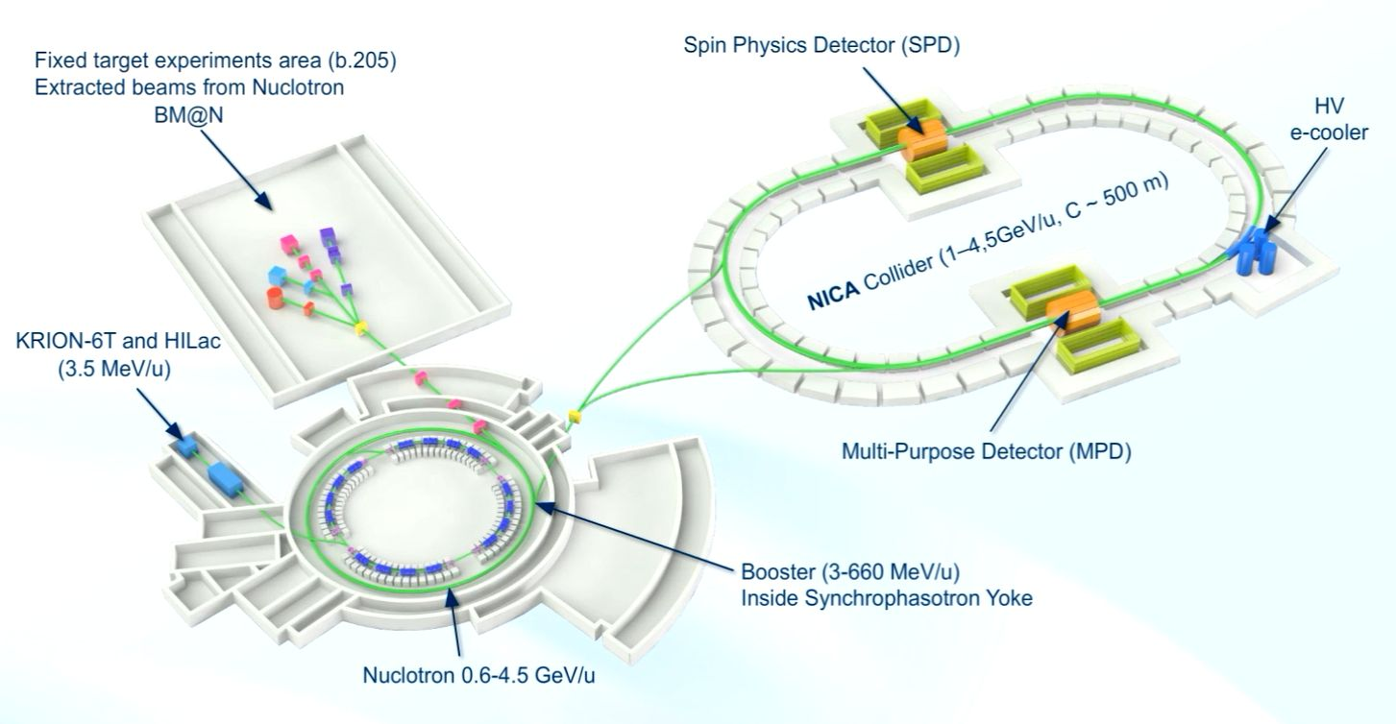
Introduction
The Nuclotron-based Ion Collider fAcility project at JINR
is aimed at generation of intense heavy ion and polarized nuclear beams for searching the baryonic matter of a high density at modest temperature and investigation of polarization phenomena.
NICA Collider basic parameters:
√s_{NN} = 4 - 11 GeV heavy ion colliding beams
at the luminosity L ~ 10²⁷ cm⁻² c⁻¹ (Au)
and polarized p↑ (d↑) of √s_{NN} up to 26 (13) GeV at L ~ 10³² cm⁻² c⁻¹

Slide 4

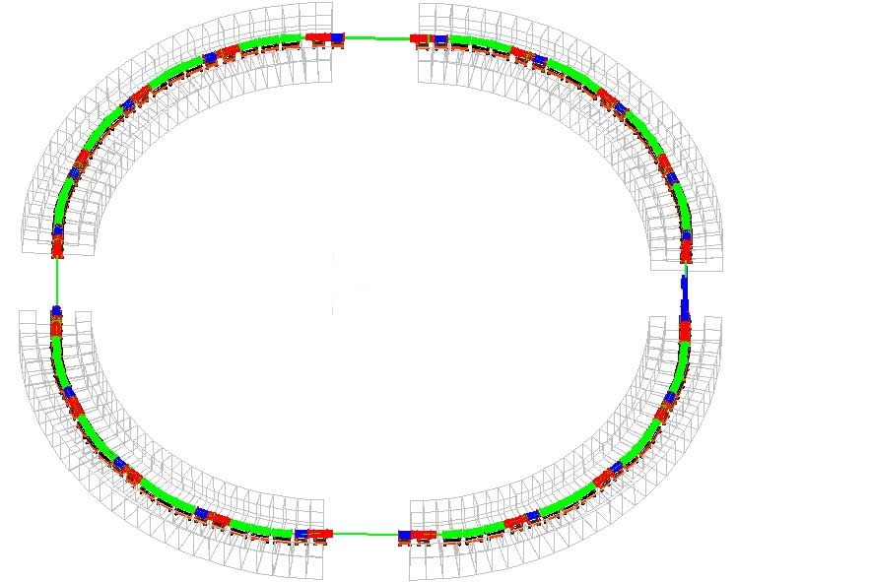
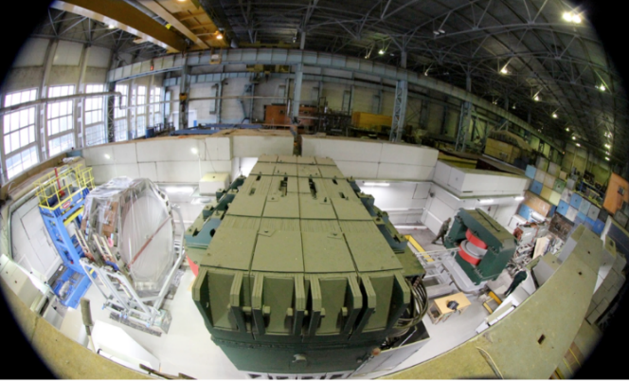
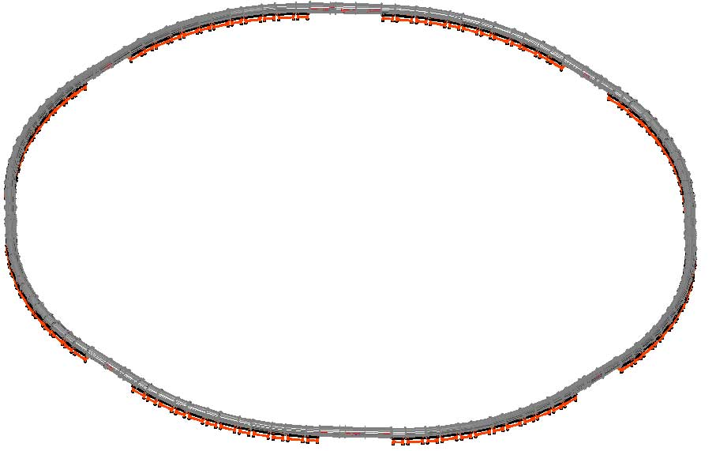
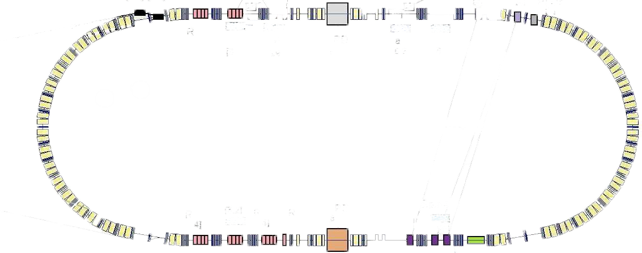
1. NICA @ Heavy Ion mode
– 1st & 2nd Stages of The Project
Linac HILac (3.2MeV/u)
ESIS KRION
Booster (25 Tm)
1(2-3) single-turn injection,
storage of (2 ÷ 4)×10⁹ ions,
acceleration up to 100 MeV/u,
electron cooling, acceleration
up to 600 MeV/u
Linac LU-20 (5MeV/u)
Ion sources
Baryonic Matter @ Nuclotron
BM@N: NICA – Stage I
Fixed Target Area
Stripping (80%) ¹⁹⁷Au³¹⁺ => ¹⁹⁷Au⁷⁹⁺
√s = 2.3 – 3.6 GeV/u (Au × Au)
Nuclotron (45 Tm)
injection of one bunch
of ≤ 2×10⁹ ions,
acceleration up to
1 - 4.5 GeV/u max.
Two SC rings of the collider
NICA – Stage II
L ≥ 10²⁷ см⁻²с⁻¹
~ 2 x 22 injection cycles
22 bunches per ring
MPD

Slide 5
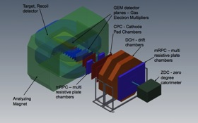
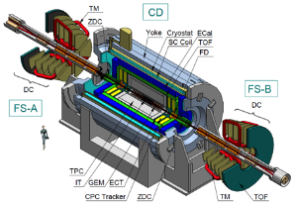
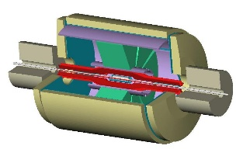
1. NICA @ Heavy Ion mode: 1st & 2nd Stages of The Project
In operation
Under construction
1. NICA @ Heavy Ion mode
1st & 2nd Stages of The Project
Fixed target experiments
Booster synchrotron
(600 MeV/u)
Nucloron 0.6-4.5 GeV/u
HILAc
(3 MeV/u)
MPD
Linac LU-20 (5 MeV/u)
BM@N
Electron cooler
(2.5 MeV)
C
SPD
o
l
l
r
i
d
e

Slide 6
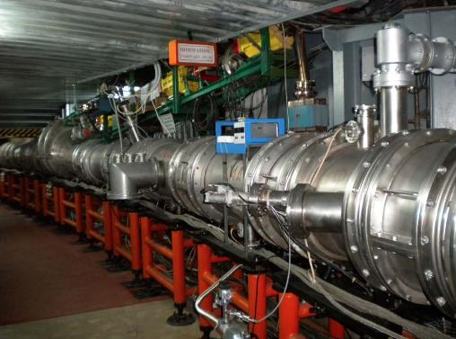
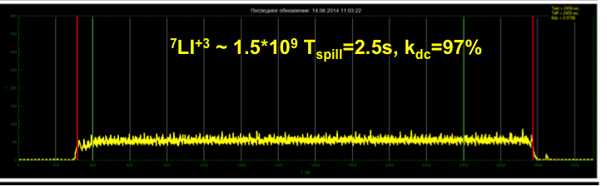
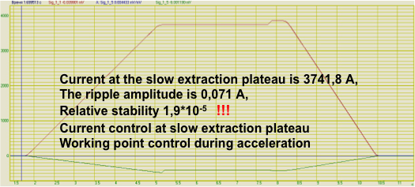
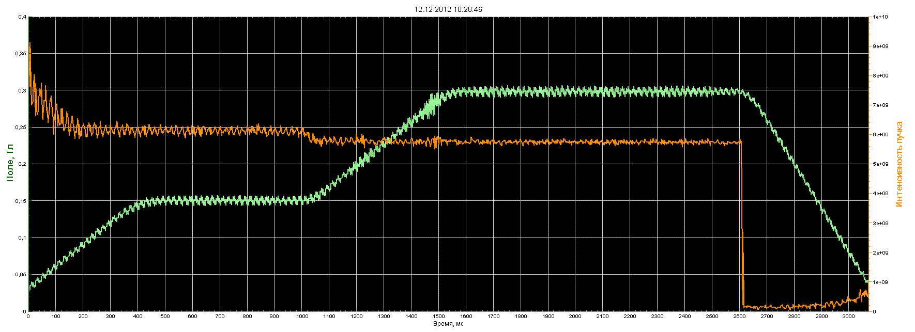
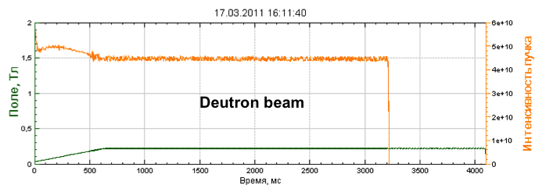
2. NICA construction
Status of The Nuclotron
Ion beams for fixed target: p, d, Li, C, Ar, Fe, … Xe
Nuclotron – 4.5 AGeV, 251 m.
superconducting synchrotron.
Commissioned in 1993,
Upgraded in 2011.
Adiabatic debunching and recapture at efficiency of about 95% was demonstrated

Slide 7
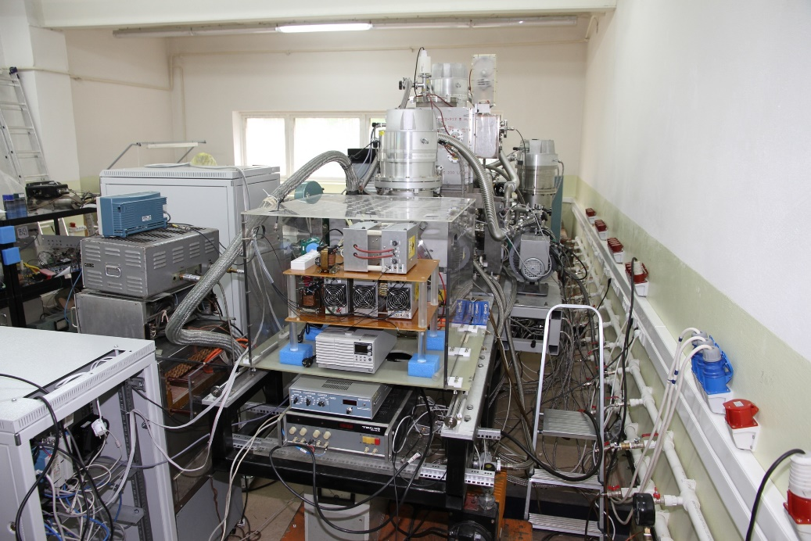
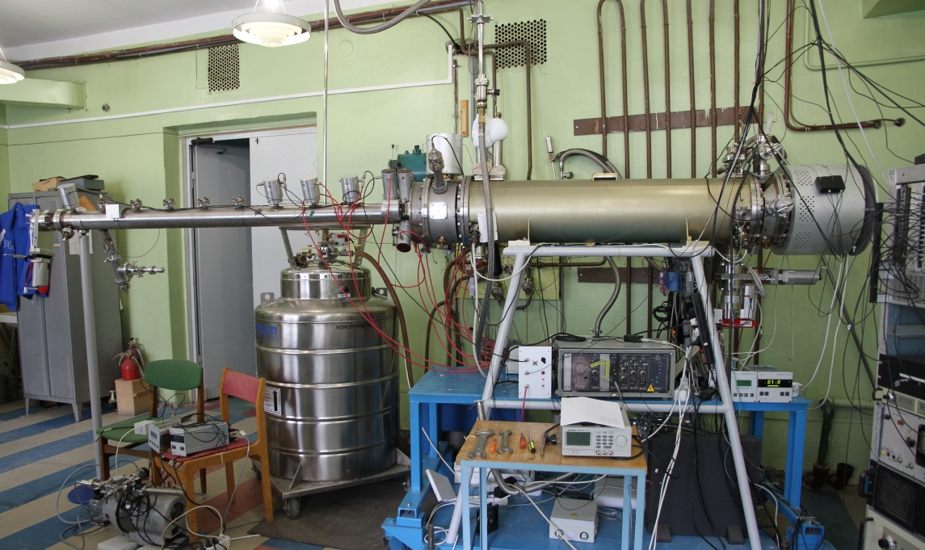
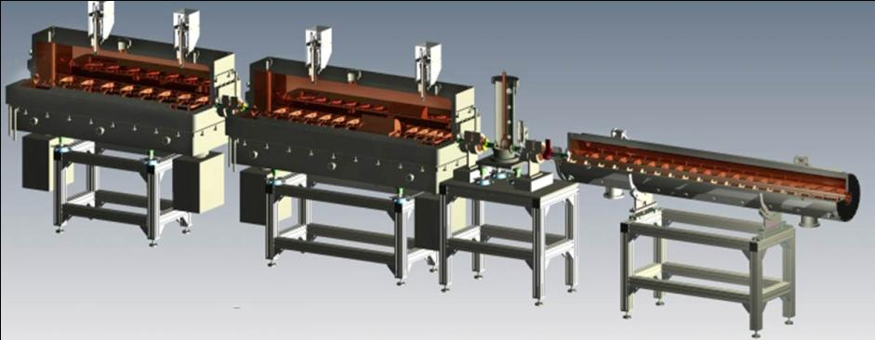

New injection complex of the NICA (Ion sources + HILAc)
Source for polarized particles (SPP)
Heavy ion source: Krion-6T ESIS
2. NICA construction
Source had been commissioned,
achieved 10¹⁰ deutrons pp.
First beam run in June 2016
B= 5.4T reached. Test Au beams produced:
- Au³⁰⁺ ÷ Au32³²⁺, 6*10⁸, T_{ionization}= 20 ms for
- Au³¹⁺ -> repetition rate 50 Hz.
- ion beams Au⁵¹⁺÷ Au⁵⁴⁺ are produced.
Heavy Ion Linear Accelerator under commissioning at JINR.

Slide 8
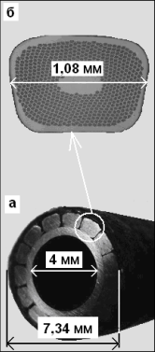
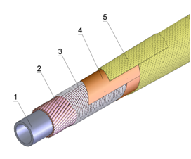
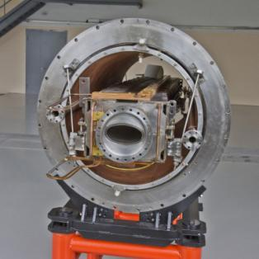
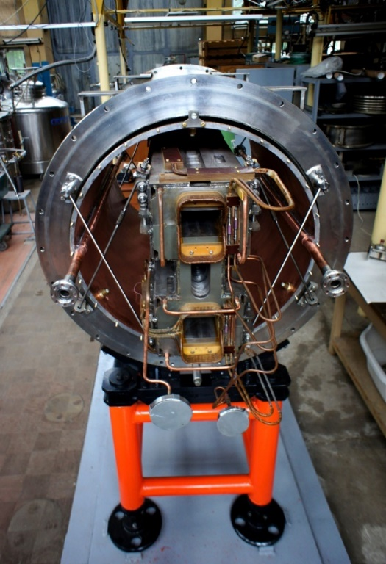
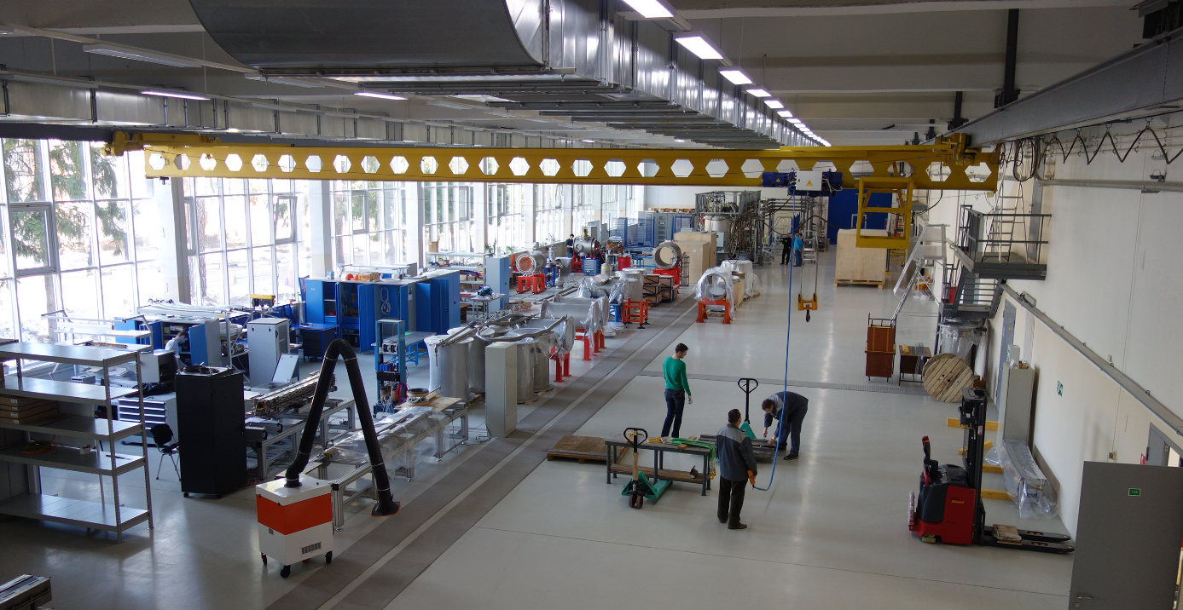
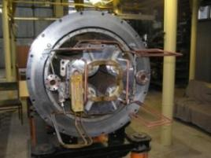
2. NICA construction
Superconducting superferric “Dubna magnets”
“Nuclotron-type”
SC hollow cable
Booster dipole
Max. B field = 2T
Ramp rate – up to 4 T/s @ 1 Hz
two-phase LHe @ 4.5K
Collider
“twin” dipoles
Booster
quadrupole lens
The Magnet Plant

Slide 9
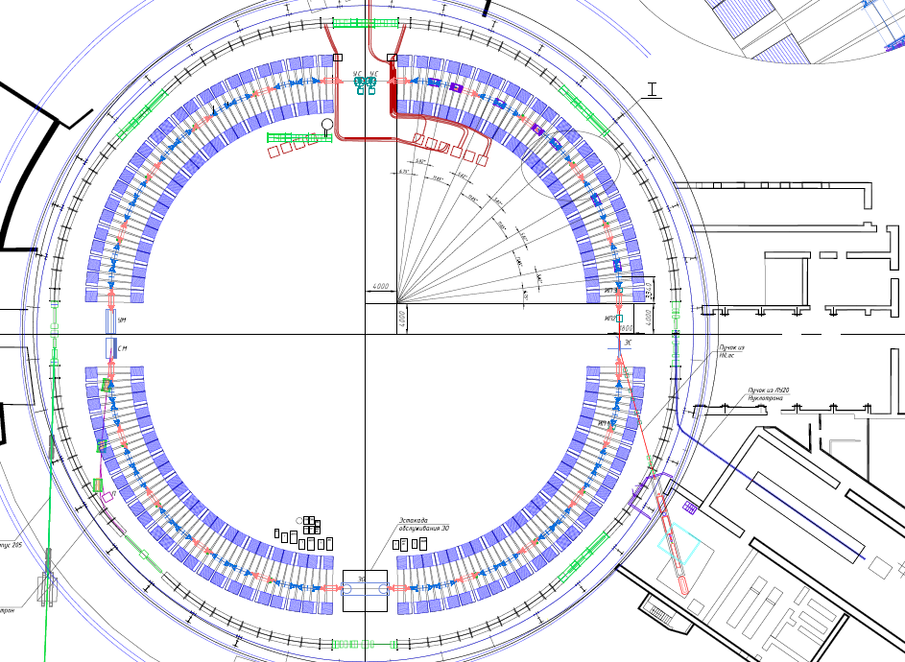
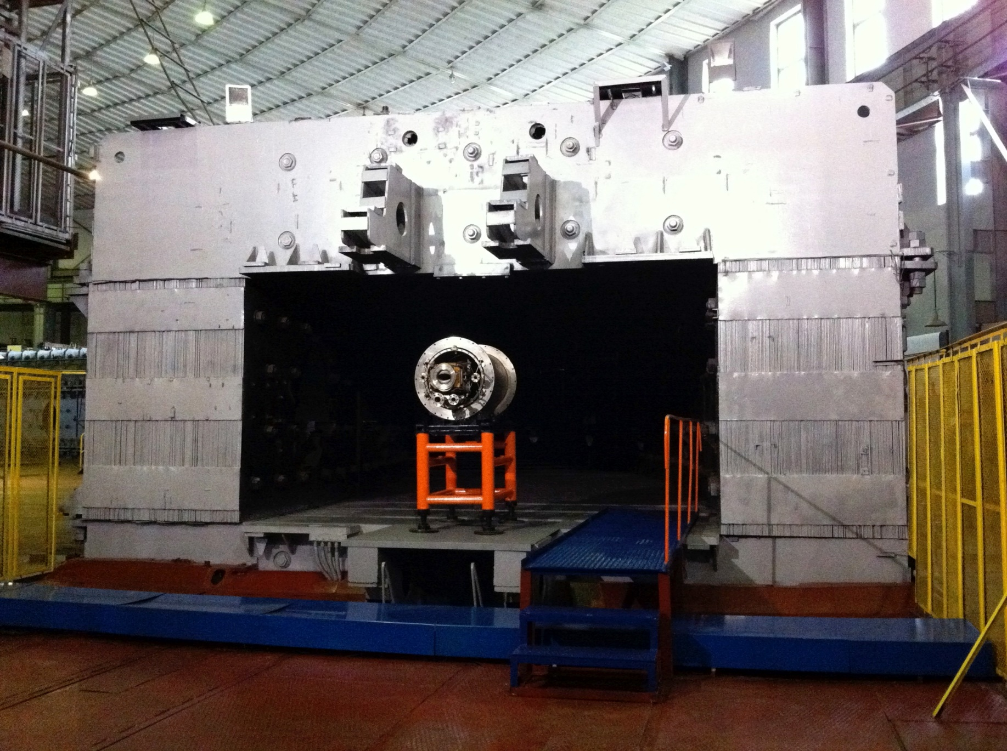
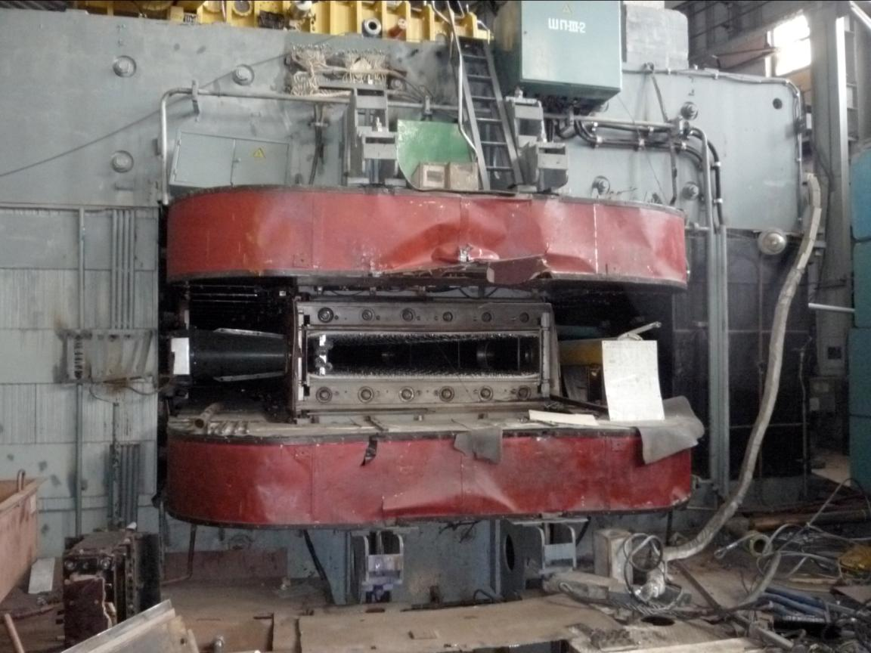
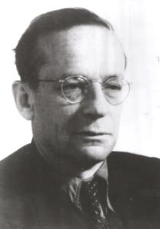
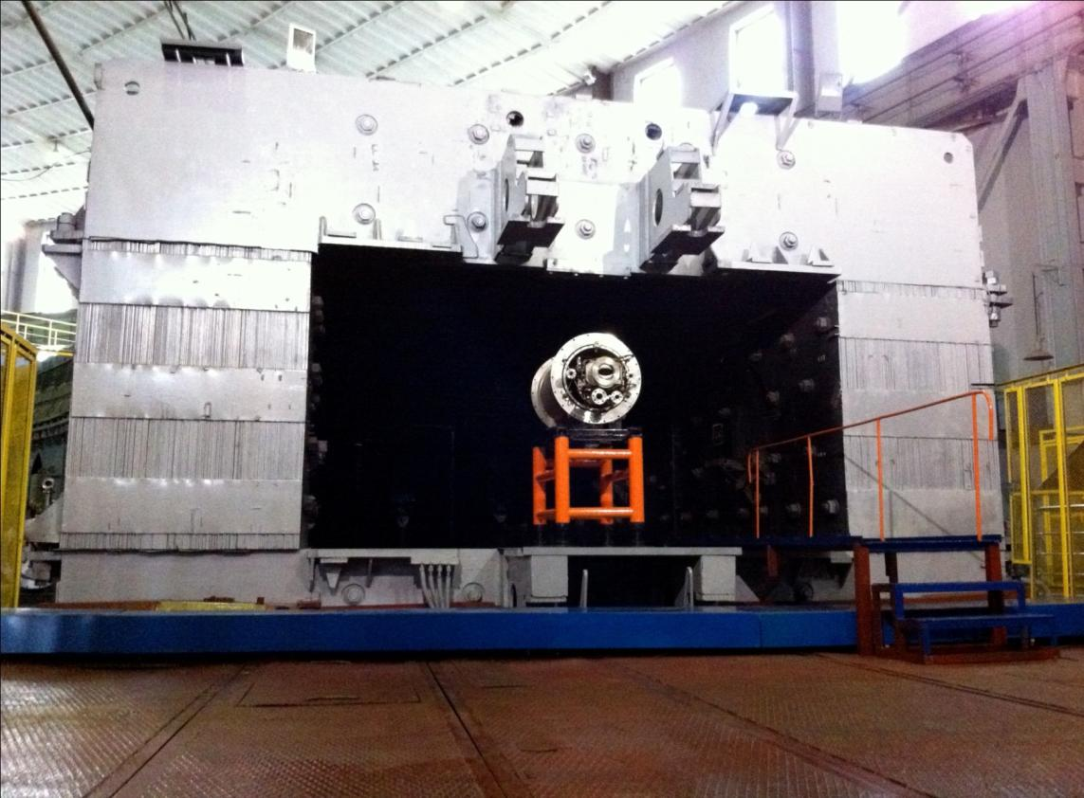
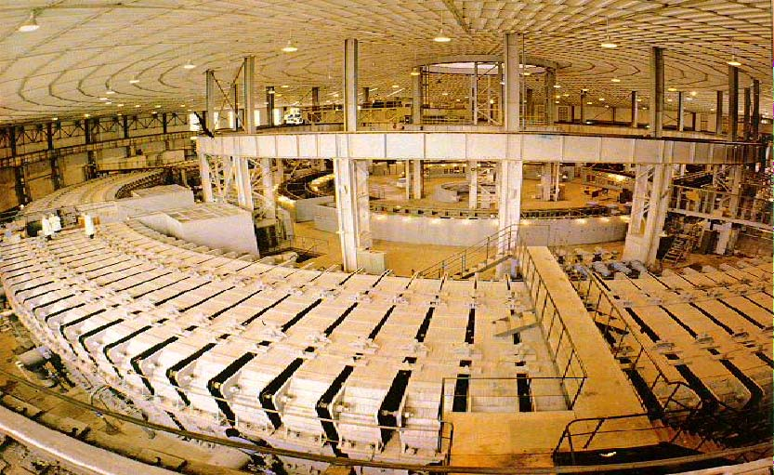
2. NICA construction
NICA Booster synchrotron
The best method to measure phase space size
Prototype of the Booster dipole
V. Veksler
2.4 m
2.3 m
4.0 m
4.0 m

Slide 10
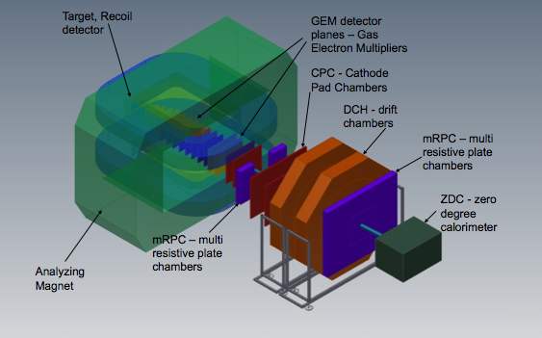

2. NICA construction
BM@N and MPD
Baryonic Matter @ Nuclotron
(BM@N)
The fixed target experiment
at the Nuclotron - NICA Stage I
2017 – start
Au × Au
√s_{NN} = 2.3 – 3.6 GeV/u
MultiPurpose Detector
(MPD)
The collider experiment
at NICA Stage II
2020 - start up mode

Slide 11
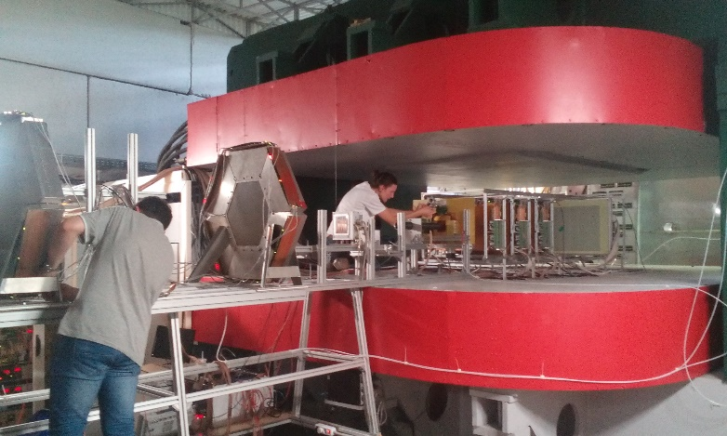
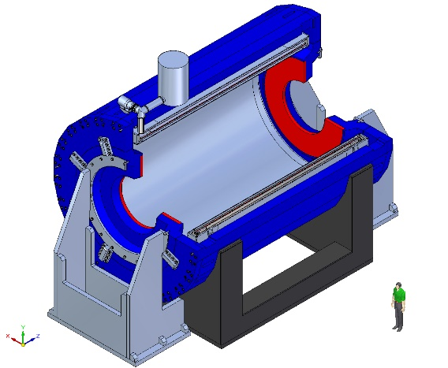
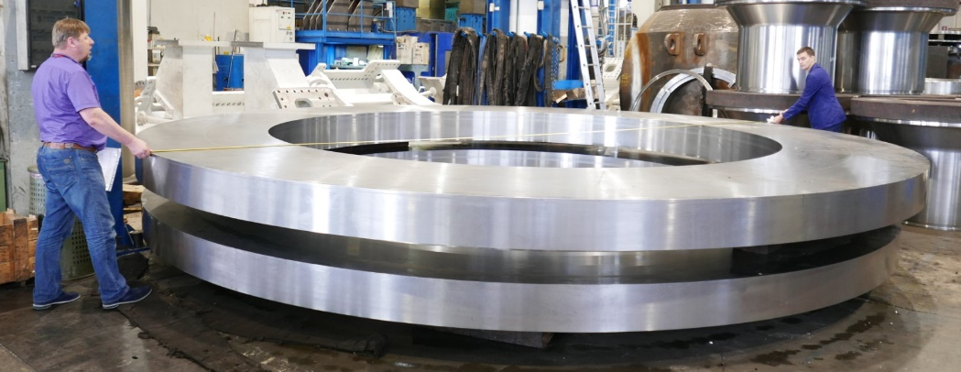
2. NICA construction
BM@N and MPD
Baryonic Matter @ Nuclotron
(BM@N)
June 2016:
Tests & commissioning at the Nuclotron beam subdetector located inside analyzing magnet
MultiPurpose Detector (MPD)
MPD superconducting Solenoid:
B₀ = 0.66 T , ΔB/B ≤ 1e-4 in TPC area
Weight ~ 900 t
ASG superconducting (Genova, Italy):
Cold Mass + Cryostat, Vacuum System
Trim Coils
Control System & Power Supplies
General responsibility
Control Dewar & pipe lines
SC coil
Cryostat
Trim Coil
Solenoid yoke
Vitkovice Heavy Machinery, Sept. 5, 2016

Slide 12
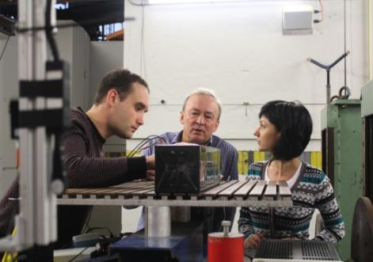
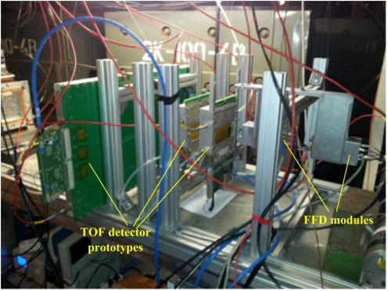
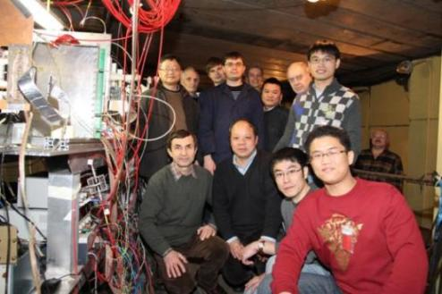
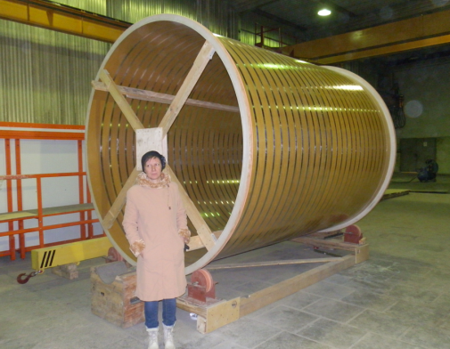
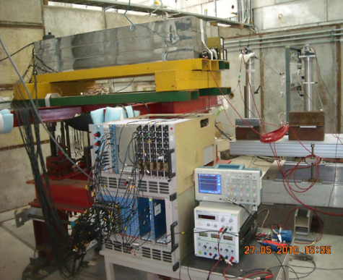
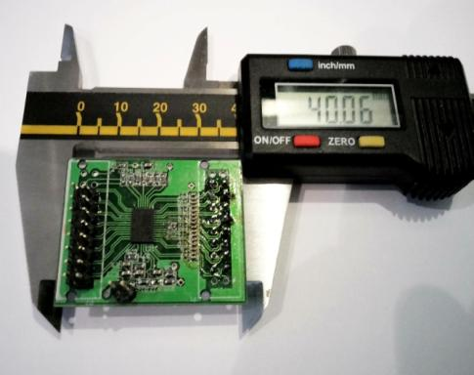
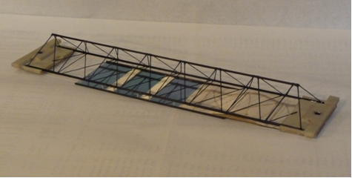
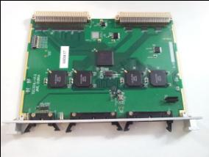
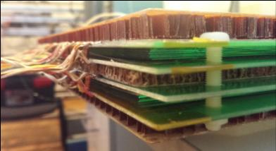
RPC deam test at NUCLOTRON: cooperation with SPb, China
FFD tested with beam: achieved time resolution (38 ps) is better than required
Preproduction ECAL prototypes: co-operation with Ukraine and China
Fabrication of MPD Subdetectors
Readout Electronics developed for TPC, TOF, and ECAL (64 ch,13-bit,65 MSPS)
TPC Cylinder C3 manufactured in Dec’13
ZDC coverage confirmed: 2.2<|η|< 4.8
RPC performance : required efficiency, rate capability & time resolution (63 ps) had been reached
The CBM - MPD consortium: development & production of STS for CBM (FAIR), MPD & BM@N
mock-up carbon-fiber ladder (15 g / 1m)

Slide 13
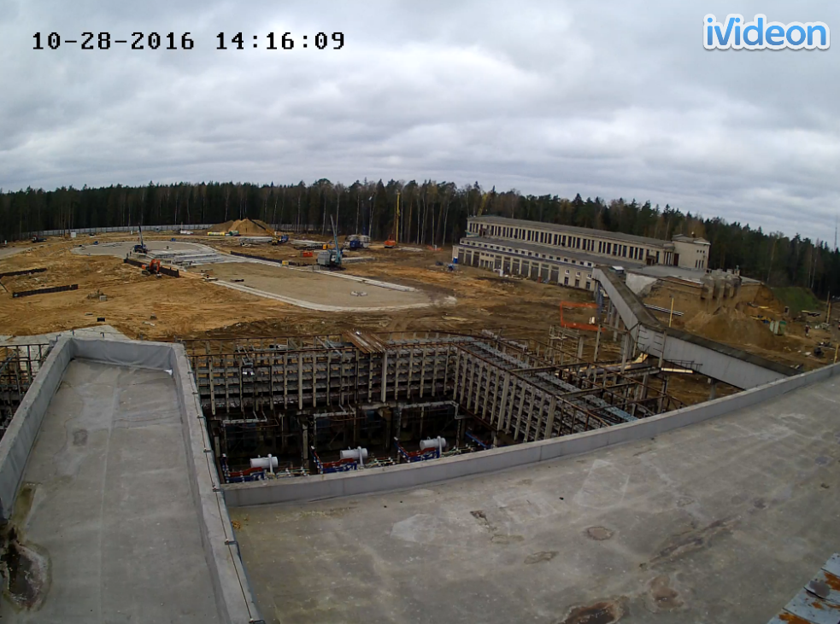
2. NICA construction
Construction of The Collider Building
October 28, 2016 Collider site

Slide 14

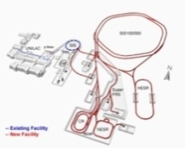







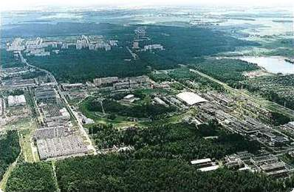
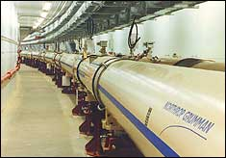
2. NICA construction
NICA Collaboration
Budker INP:
Booster RF system, e-cooler
Collider RF systems
HV e-cooler for collider
Channel Nuclotron-Collider (?)
GSI/FAIR
SC magnets for
Booster/Collider/SIS-100,
UHV, beam cooling, diagnostics
FZ Juelich (IKP)
HV Electron cooler
Stochastic cooling
INP RAS, Troitsk:
Polarised ion source,
Beam diagnostics
Fermilab
HV Electron cooler
Beam dynamics, stoch. cooling
[HeliumMash, CryogenMash (Moscow)]
CERN
SC and magnet technologies,
Rad.safety, energetics,
Beam cooling and dynamics,
Metrology
Alikhanov ITEP
Beam dynamics, RFQ linac for LU-20
MEPhI, ARITP (Snezhinsk):
RFQ linac for LU-20
iThemba Labs & 6 others (RSA)
Elements of the NICA accelerators
IHEP, Protvino
Beam dynamics,
Feed-back systems
BNL (RHIC)
Beam dynamics,
Stochastic cooling

Slide 15
3. Strategy of The Project Luminosity Achievement
Maximum r.m.s. bunch length is chosen equal to 0.6 m to have the “luminosity concentration” at Inner Tracker (IT) of MPD.
2. Maximum peak luminosity (limited by the beam space charge – the Lasslett tune shift) is achieved at maximum emittance:
E_{rms} = 1.1 π⋅mm⋅mrad (the beam radius = 1/6 of the ring aperture).
3. Maximum ion number per bunch is limited by
the tune shift value ≤ 0.05.
4. Number of bunches = 22 => to avoid parasitic collisions of the bunches in the common part of the Collider straight section.
5. RF multiplicity = 3 => separatrix area is by 25 times exceeds the beam longitudinal emittance.
6. The ratio between horizontal, vertical emittances and ion momentum spread is defined by the equilibrium of IBS rates for each degree of freedom.

Slide 16
3. Strategy of The Project Luminosity Achievement
Nuclotron Beams
Parameter | Achieved |  | Project (2017 - 2020)
Magnetic field, T | 2.0 |  | 2.0 (Bρ = 42.8 T⋅m)
Field ramp, T/s | 0.8 |  | 1.0
Repetition period, s | 8.0 |  | 5.0
 | E, GeV/u | Ions/cycle | Energy, GeV/u | Ions/ cycle
Light ions ⇒ d | 5.8 | 2⋅10¹⁰ | 6.0 | 5⋅10¹⁰
Heavy ions | With KRION-2 |  | With KRION-6T & Booster
⁴⁰Ar¹⁸⁺ | 3.5 | 5⋅10⁶ | 4.9 | 1⋅10⁸ 2⋅10¹⁰
⁵⁶Fe²⁶⁺ | 2.5 | 2⋅10⁶ | 5.4 | 1⋅10⁸ 1⋅10¹⁰
¹²⁴Xe^{48/42+} | 1.5 | 1⋅10³ | 4.0 | 1⋅10⁷ 2⋅10⁹
¹⁹⁷Au⁷⁹⁺ | --- | --- | 4.5 | 1⋅10⁷ 2⋅10⁹
Polarized beams | With Polaris |  | With SPI
p↑ | --- | --- | 11.9 | 1⋅10¹⁰ **)
d↑ | 2.0 | 5⋅10⁸ | 5.6 | 1⋅10¹⁰
NICA Stage II
With KRION-6T & Booster
**)
**) With the Siberian snake and upgraded RF systems

Slide 17
3. Strategy of The Project Luminosity Achievement
The NICA Collider
Collider lattice:
FODO,
12 cells x 90⁰
each arc
Circumference, m | 503.04
Number of bunches | 22
rms bunch length, m | 0.6
β-function in IP, m | 0.35
Betatron tunes, Q_{x}/Q_{y} | 9.44 / 9.44
Chromaticities, Q’_{x}/Q’_{y} | -33 / -28
Ring Acceptance, π mm·mrad | 40
Momentum acceptance, Δp/p | ±0.010
γ_{tr} | 7.088
Kinetic energy of Au⁷⁹⁺, GeV/u | 1.0 | 3.0 | 4.5
Number of ions per bunch | 2.0·10⁸ | 2.4·10⁹ | 2.3·10⁹
Δp/p_{rms}, 10⁻³ | 0.55 | 1.15 | 1.5
ε_{rms}, (h/v) π mm·mrad | 1.1/0.95 | 1.1/0.85 | 1.1/0.75
Luminosity, cm⁻² s⁻¹ | 0.6·10²⁵ | 1·10²⁷ | 1·10²⁷
IBS growth time, s | 160 | 460 | 1800
Tune shift, ΔQ_{total} =ΔQ_{SC} +2ξ | -0.050 | -0.037 | -0.011

Slide 18
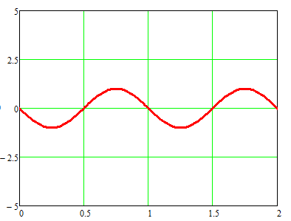
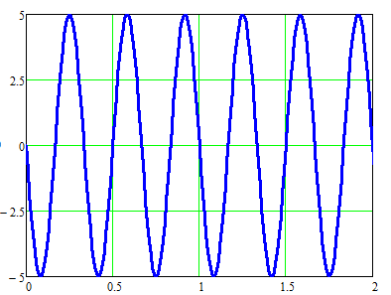
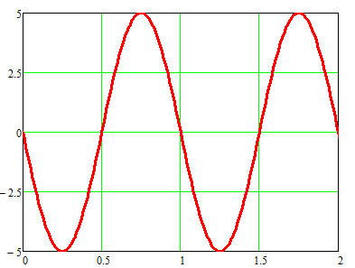
3. Strategy of The Project Luminosity Achievement
RF Gymnastics in The Collider
Step 1: Cooling and stacking with RF1 barrier voltage (< 5 kV). Accumulation efficiency ~ 95%, about 110 - 120 injection pulses (55-60 to each ring) every 5 sec. Total accumulation time ~ 10 min. Ion momentum spread is limited by microwave instability.
Steps 2-3. Formation of the short ion bunches at presence of cooling:
RF-2 (100 kV, 4 resonators) => RF-3 (1MV, 8 resonators).
From coasting beam to => 22nd harmonics => 66th harmonics
V_{RF} & ion bunches ,
arb. units
Phase, arb. units

Slide 19
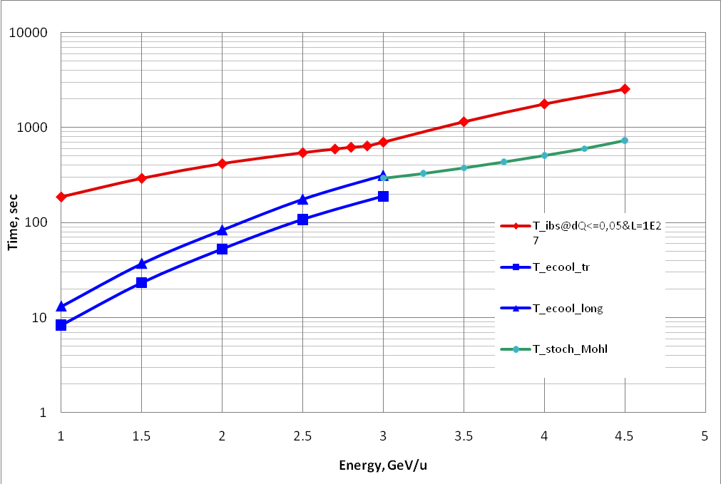
3. Strategy of The Project Luminosity Achievement
Two modes of the collider operation
SC dominated regime:
Electron cooling is
used to provide optimum
phase volume.
IBS dominated regime:
Stochastic cooling
to supress beam
Expansion IBS
Effective stacking
with E-Cooling
Space charge dominated mode (ΔQ ≤ 0.05) | IBS dominated mode
ε and dP/P are optimized independently. The bunch relaxation is suppressed by cooling. Luminosity is limited by space charge effects | ε and dP/P are “equi-partitioned”, either fast bunch relaxation. Luminosity can be obtained at small ΔQ<0.05

Slide 20
3. Strategy of The Project Luminosity Achievement
Two modes of the collider operation
Electron and stochastic cooling application!
10
L(E_{i})
1e27 cm⁻²⋅s⁻¹
1.0
0.1
0.01
10
Ion/bunch,
1E9
1.0
0.1
0.01
Emittance reduction with energy:
N_{max}
L_{max}
N_{opt}
N_{opt}
Equilibrium beam emittance vs E_{ion} , π⋅mm⋅mrad
L_{opt}
L_{opt}
1.2
ε(E_{i})
0.8
0.4
0
ε_{opt}
ε_{max}
ε_{opt}
1 2 3 4
Ion energy, GeV/u
Space charge IBS
dominated mode dominated
mode
1 2 3 4
Ion energy, GeV/u
Maximum of the Collider luminosity L_{opt} is limited
by the MPD counting rate!

Slide 21
3. Strategy of The Project Luminosity Achievement
Strategy to keep Average Luminosity
Effective scheme of particle accumulation and bunch formation
Beam lifetime (if limited by scattering on residual atoms) ~ 10 h
“Head-tail” and multibunch instabilities are suppressed
by the feed-back systems.
4. Emittance growth due to IBS – suppressed by the beam cooling,
both electron and stochastic ones:
E_{kin} = 1 – 3 GeV/u – with electron cooling only,
E_{kin} = 3 – 4.5 GeV/u – with 3D stochastic and electron cooling.

Slide 22
4. Start up mode of NICA operation
The beginning of the NICA accelerator complex commissioning
is scheduled for 2020
The complex will be commissioned with
- Injectors chain
- Transfer channels
- Collider in start up version, i.e:
with RF-1 and RF-2, but without RF-3
with Stoch. Coolg system - one channel per ring (long. cooling)
without Electron Cooler
without feed-back system
It will allow us to provide collider operation in the energy range of
√s_{NN} = 4 - 6 GeV ( ¹⁹⁷Au⁷⁹⁺ ions)
at the luminosity of
L_{start} ≤ 5x10²⁵ cm⁻²⋅s⁻¹

Slide 23
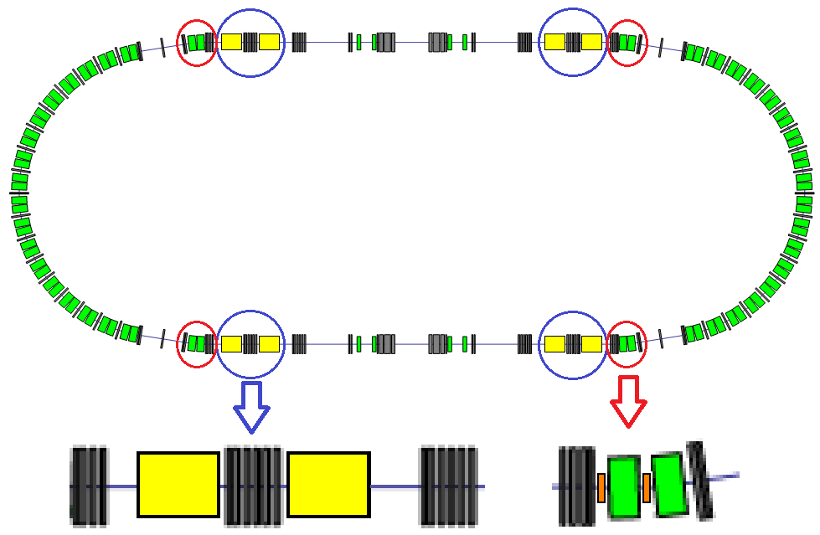
5. NICA – Stage III: Collider of polarized beams
One of very preliminary versions -
to be analyzed and developed.
MPD
Polarization
Control
1-st Solenoid SS
Polarization
Control
2-nd Solenoid SS
Spin Physics Detector (SPD)
SPD
Spin diagnostics + Superconducting solenoids at field < 8 T

Slide 24
6. Requirements and questions (to be discussed and answered)
6.1. Choice of colliding nuclei
¹⁹⁷Au⁷⁹⁺ × ¹⁹⁷Au⁷⁹⁺ - main project option
¹⁹⁷Au⁷⁹⁺ × p – main candidate for asymmetric collision mode
The questions:
Are these options optimal ?
Are the following symmetric colliding nuclei modes of the interest:
²³⁸U⁹²⁺ × ²³⁸U⁹²⁺, ²⁰⁸Pb⁸²⁺ × ²⁰⁸Pb⁸²⁺, ²⁰⁹Bi⁸³⁺ × ²⁰⁹Bi⁸³⁺, ¹³¹Xe⁵⁴⁺ × ¹³¹Xe⁵⁴⁺ ?
Are the following asymmetric collision modes of the interest:
¹⁹⁷Au⁷⁹⁺ × d (α, ⁷Li³⁺, ¹²C⁶⁺,…) ?
Replacing protons by the light ions (even deuteron!) simplifies significantly the Collider modifications for an asymmetric colliding nuclei mode.
6.2. Energy scan
a) What should be desirable energy step ?
b) What should be a precision, reproducibility and stability of
the chosen energy value ?
c) Do we need energy asymmetry of the colliding nuclei ?

Slide 25





6. Requirements and questions (to be discussed and answered)
6.3. Luminosity
a) Choice of the betatron function value in the interaction point (IP) – so called β*
The increase of β* leads to reduction of the luminosity (can be compensated (!), for instance, by increase of nuclei number), but allows one to resolve the problems of the Collider focusing systems!
The question: how does it influence on MPD characteristics ?
9010 mm
Inner Tracker of MPD
Integral luminosity vs s
normalized by
project luminosity L at
β* = 35 cm, σ_{s} = 60 cm)
Local luminosity vs s
normalized by
project luminosity
dL/ds at s = 0 and
β* = 35 cm, σ_{s} = 60 cm)
1.0
0.8
0.6
0.4
0.2
0
β_{min} = 35, 60, 100 cm
σ_{s} = 60 cm
-100 -50 0 50 100
s [cm]
β* = 35, 60, 100 cm , σ_{s} = 60 cm

Slide 26
6. Requirements and questions (to be discussed and answered)
6.3. Luminosity
b) MPD – what are upper and lower limits of counting rates (luminosity) ?
The upper level is known: 7 kHz. Can it be increased ?
The lower level – which (minimal) level of luminosity is of experiment interest ?
c) How absolute calibration of the luminosity can be performed at MPD ?
Usual method of calibration assumes measurement of the flux of small-angle
scattering particles in the collider. Is it foreseen at MPD ?
6.4. Collider and MPD synchronization
Traditional method of synchronization is control of the phase of rotating bunches in the ring. It allows one to tune the bunch rotation frequency and optimize the collision regime. The signal from collider control system can be used as a trigger allowing to “open” or “close” registration of reaction species and to measure background level. Such a system is under development by collider team and it’s time to coordinate common afforts.

Slide 27
Concluding remarks:
NICA complex has a potential for competitive research
in dense baryonic matter and spin physics.
NICA has large international and fruitful cooperation with
many physics research centers in Russia and around
the World .
- The construction of the NICA collider complex and both
detectors BM@N & MPD goes close to the schedule.
We welcome new partners !
Thank you for your attention!

Slide 28
Back up slides

Slide 29
NICA time-line
 | 2015 |  |  |  | 2016 |  |  |  | 2017 |  |  |  | 2018 |  |  |  | 2019 |  |  |  | 2020 |  |  |  | 2021 |  |  |  | 2022 |  |  |  | 2023
Injection complex
Lu-20 upgrade
HI Source
HI Linac
Nuclotron
general development
extracted channels
Booster
Collider
startup configuration
design configuration
BM@N
I stage
II stage
MPD
solenoid
TPC, TOF, Ecal (barrel)
upgraded end-caps
Civil engineering
MPD Hall
SPD Hall
collider tunnel
HEBT Nuclotron-collider
Cryogenic
for Booster
for Collider
running time

Slide 30
6. Requirements and questions (to be discussed and answered)
What optimal step energy scan @ NICA could be expected?
What are optimal heavy ion species for collision? (U x U, or Au x Au, or Pb x Pb, or Bi x Bi, or Xe x Xe, similar or asimmetrical or isobars, p/d x HI, LI x HI)…
Minimal required detector space @ IP along the beam
Required modes of data acquisition (limitations, cycle, etc), collimation of the beam, requirements to the background “dead-time of detector”, requirements to the synchronization, are fragments from the pereferical collisions interesting ?
…. (to be cntd by weeknd)
1) какой уровень светимости "уже интересен"?
MPD – upper and lower limits of counting rates (luminosity)
2) как влияет "длинная" светимость на работу MPD, т.е. dL/ds?
3) асимметричный режим - нужны ли протоны, или можно обойтись лёгкими ионами?
4) скан по энергии - диапазон, шаг, статистика на каждой точке энергии, воспроизводимость режимов?
5) Выбор сталкивающихся частиц –
А) сорт ядер
Б) асимметрия по массе – лёгкие х тяжёлые
6) Нужна ли симметрия по энергии?
running time

